Slide 1
Introduction to Test First Development
Anton Kratenok

Slide 2
Content
Introduction to Developer Testing
Unit Testing Frameworks
Test First Development
Test First Practices

Slide 3
Introduction to Developer Testing

Slide 4
First reaction
“I don’t test. I’m the developer.“
- typical programmer
“I don’t pay to developers for testing. I pay to QA for that.“
- typical manager

Slide 5
Some statistic

Slide 6


Slide 7
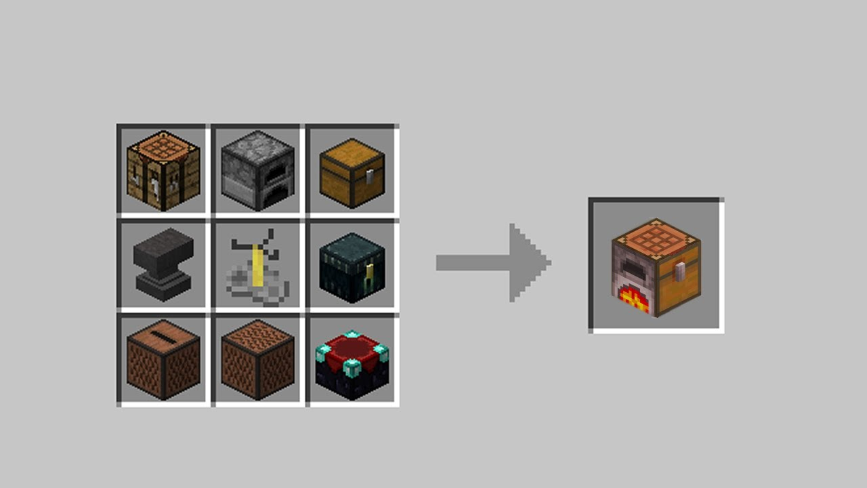
The old way
Sample001
Notes:
Show samplex01

Slide 8
Benefits
Higher quality – fewer bugs
Documentation as a part of a project
Well structured code
Regression issues protection

Slide 9
Less statistic for managers

Slide 10
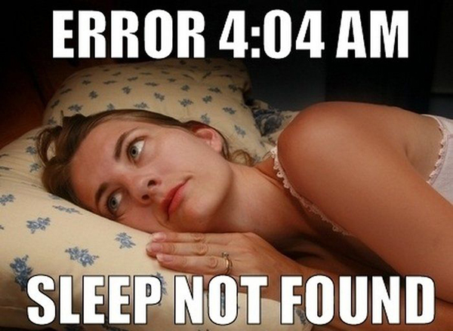

Slide 11
Mission
Unit tests are responsible for the functionality of small modules \ classes \ component in a large system.

Slide 12
New & Existing
Greenfield
Legacy

Slide 13
Testing process
Code
Test fails
Test success

Slide 14
Unit Testing Frameworks

Slide 15
What’s good?
You don’t need to make new bicycles. Everything was developed before you
http://en.wikipedia.org/wiki/List_of_unit_testing_frameworks#.NET_programming_languages

Slide 16



3 whales
MSTest

Slide 17
How does a Framework work?
Unit Test Runner
My cute code
My assembly with tests
Testing Framework

Slide 18
Way to success tests

Slide 19
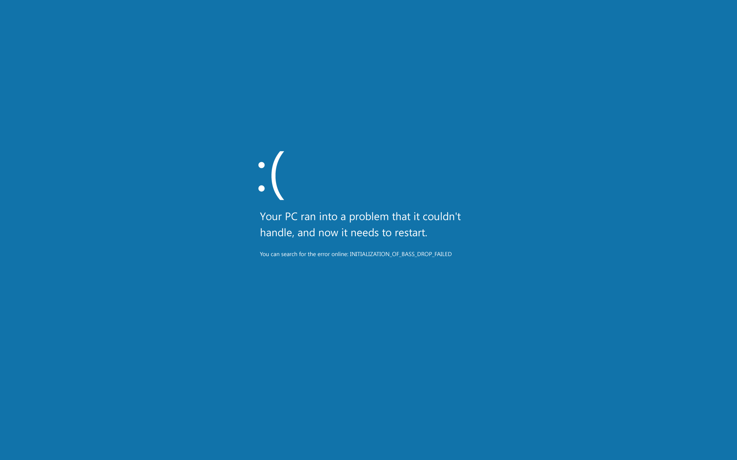

Slide 20


Slide 21

Let’s make the first failed test
And fix it after all
Notes:
Show samplex02

Slide 22
Organization structure
Test Suite
Test Fixture
Test Fixture
Test Case
Test Case
Test Case
Test Case

Slide 23
Organization structure with .Net layer
Test Suite
Test Fixture
Test Case
Test Fixture
Test Case
Assembly or Namespace
.Net class
Test method + Assertion

Slide 24
xUnit approach
Each test isolated
Context is NOT shared
You can share context

Slide 25
Testing lifecycle
Test Fixture Setup
Setup
Test
Tear Down
Test Fixture Tear Down
Setup dependent resources - Database connection - Network connection
Reset context - Reinitialize stateful dependencies - Invoke the SUT and capture results
Perform assertion - Assert it!
Clean up resources from Test and Setup scope
Clean and dispose resources from Test Fixture Setup scope

Slide 26

Live overview
Notes:
Show samplex03

Slide 27
NUnit 2.2 | MSTest | xUnit.net | Comments
[Test] | [TestMethod] | [Fact] | Marks a test method.
[TestFixture] | [TestClass] | n/a | xUnit.net does not require an attribute for a test class; it looks for all test methods in all public (exported) classes in the assembly.
[ExpectedException] | [ExpectedException] | Assert.Throws orRecord.Exception | xUnit.net has done away with the ExpectedException attribute in favor of Assert.Throws.
[SetUp] | [TestInitialize] | Constructor | We believe that use of [SetUp]is generally bad. However, you can implement a parameterless constructor as a direct replacement.
[TearDown] | [TestCleanup] | IDisposable.Dispose | We believe that use of[TearDown] is generally bad. However, you can implementIDisposable.Dispose as a direct replacement.
[TestFixtureSetUp] | [ClassInitialize] | IClassFixture<T> | To get per-fixture setup, implement IClassFixture<T>on your test class.
[TestFixtureTearDown] | [ClassCleanup] | IDisposable | To get per-fixture teardown, implement IUseFixture<T>on your test class.
[Ignore] | [Ignore] | [Fact(Skip="reason")] | Set the Skip parameter on the[Fact] attribute to temporarily skip a test.
n/a | [Timeout] | [Fact(Timeout=n)] | Set the Timeout parameter on the [Fact] attribute to cause a test to fail if it takes too long to run. Note that the timeout value for xUnit.net is in milliseconds.
[Property] | [TestProperty] | [Trait] | Set arbitrary metadata on a test
n/a | [DataSource] | [Theory], [XxxData] | Theory (data-driven test). See

Slide 28
Right things
One logical assertion per test
New test for new logical assertion
Keep test code maintainable and DRY
ACID test

Slide 29
Quality
Tests are repeatable (They shouldn’t fail at midnight)
Independent (Any order for your tests)

Slide 30
Design
Public methods to test
Think like a client
Make test more robust

Slide 31
?
WTF?!

